Slide 1

CAPSTONE PROJECT HH-23-1
Notes:
What is Presentation about: a travellers perspective to london, find airbnbs that suit your needs and put them in relation to their neighbourhoods
Presentation has 3 parts: Introduction, EDA & Dashboard

Slide 2
01
INTRODUCTION
How to book your perfect city trip

Slide 3
LONDON
19 000 000
74 241
1 653
14 011
tourists per year
Airbnbs
Cultural Attractions
Restaurants
Notes:
First Overview: huge amount of offers for tourists
Maybe sidefacts: More Tourists than New York or Paris, Airbnb Capital of the world
in a normal airbnb booking process this means one thing in particular ...

Slide 4
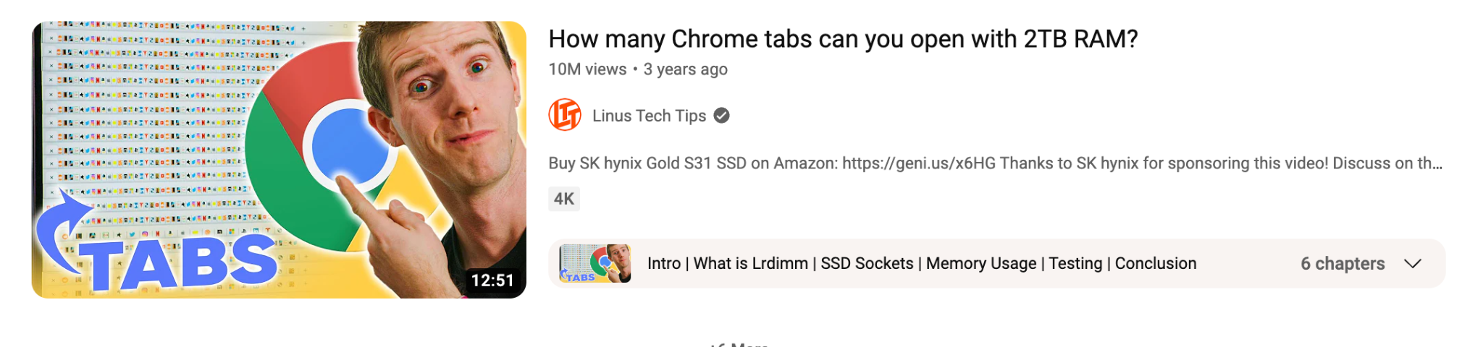
HOW (NOT) TO BOOK YOUR PERFECT CITY TRIP
Notes:
… a huge research phase for combining needs and wants with different tools: usually google maps & airbnb site
we decided to take a closer look at tourism needs, using london as an example, and translate them into a user-friendly tool

Slide 5
OUR IDEA
EDA
DASHBOARD
Finding the perfect neighbourhoods for specific traveller types
Combining Airbnb and Google Maps research for individual interests
Notes:
Combine Airbnb-service & Google Maps
EDA + Dashboard
Next slides: the cornerpillars of our project :)
For EDA we created 2 user profiles, the dashboard works for your individual needs and interests

Slide 6

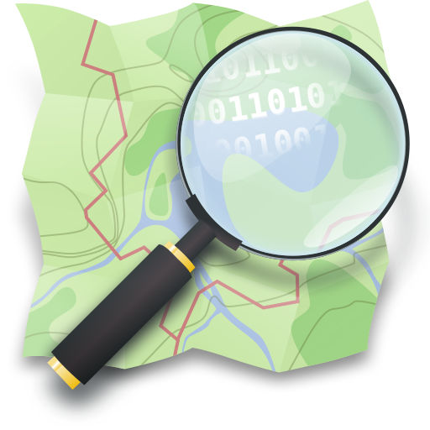
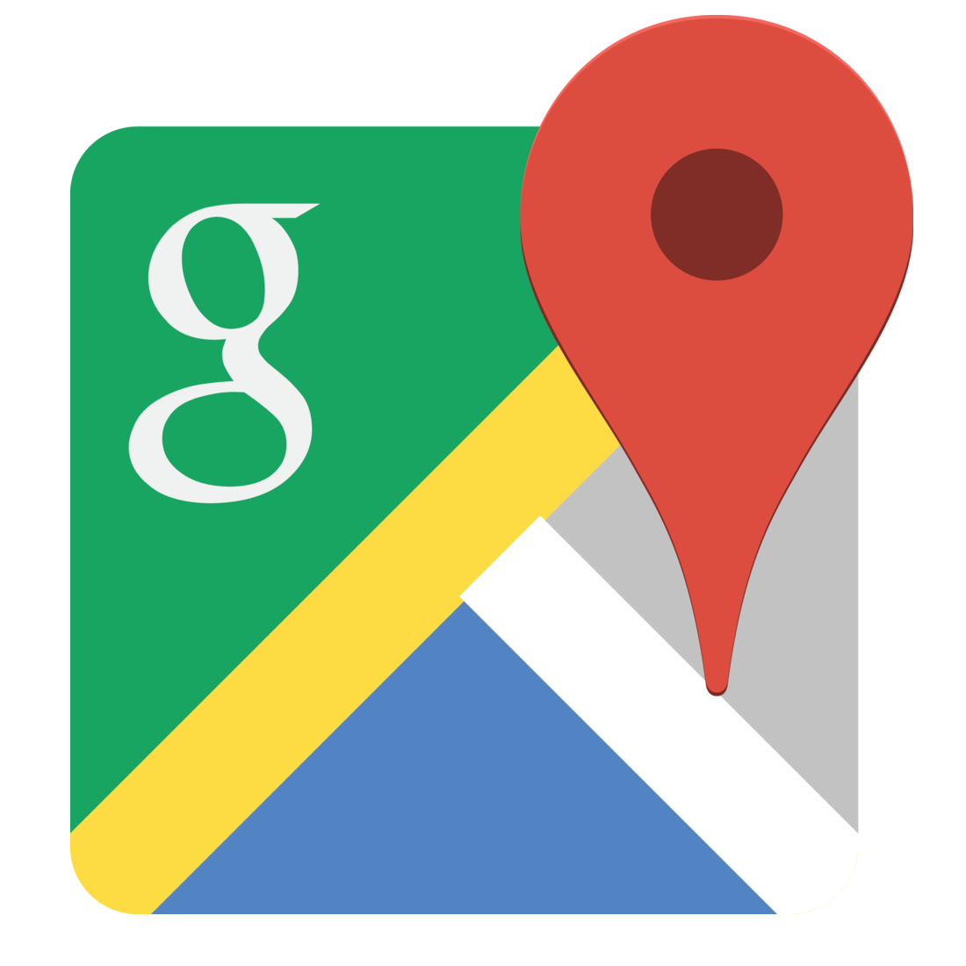
OUR RESOURCES
openstreetmap.org
insideairbnb.com
googlemaps.com
Notes:
Base of our work were this datasats: insideairbnb provides data, openstreetmap data via API, googlemaps data via webscraping

Slide 7





OUR TECHNOLOGY
PYTHON
SQL
SELENIUM
TABLEAU
AGILE METHODS
Notes:
Only read through, maybe add that selenium was our web scraping tool

Slide 8




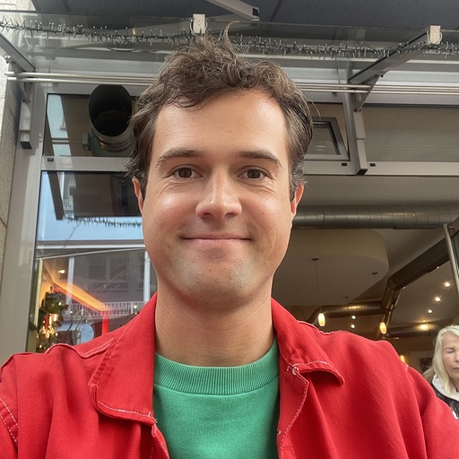
OUR TEAM
Julian Appler
Product Manager
Tourism
Markus Dittmer
Research Analyst
Insurance
Adrián Domínguez
Online
Marketing
Selina Emminger
Education Manager
Computer Science
Frederic Löbnitz
Journalist
Notes:
The friendly faces of our team <3

Slide 9
OUR INSIGHTS
02
USER ORIENTED EXPLORATORY DATA ANALYSIS
Notes:
Lets dive in the insights

Slide 10
KEY QUESTIONS
Where can travellers find their niche? Which Neighbourhoods are nice for shopping, gastronomy, going out & culture?
Which are the top neighbourhoods for specific traveller types, like the green city explorer or the budget travelling family?
Notes:
for our user oriented eda, we focused on the relationship of airbnbs to different points of interest
this led to the following key questions:

Slide 11
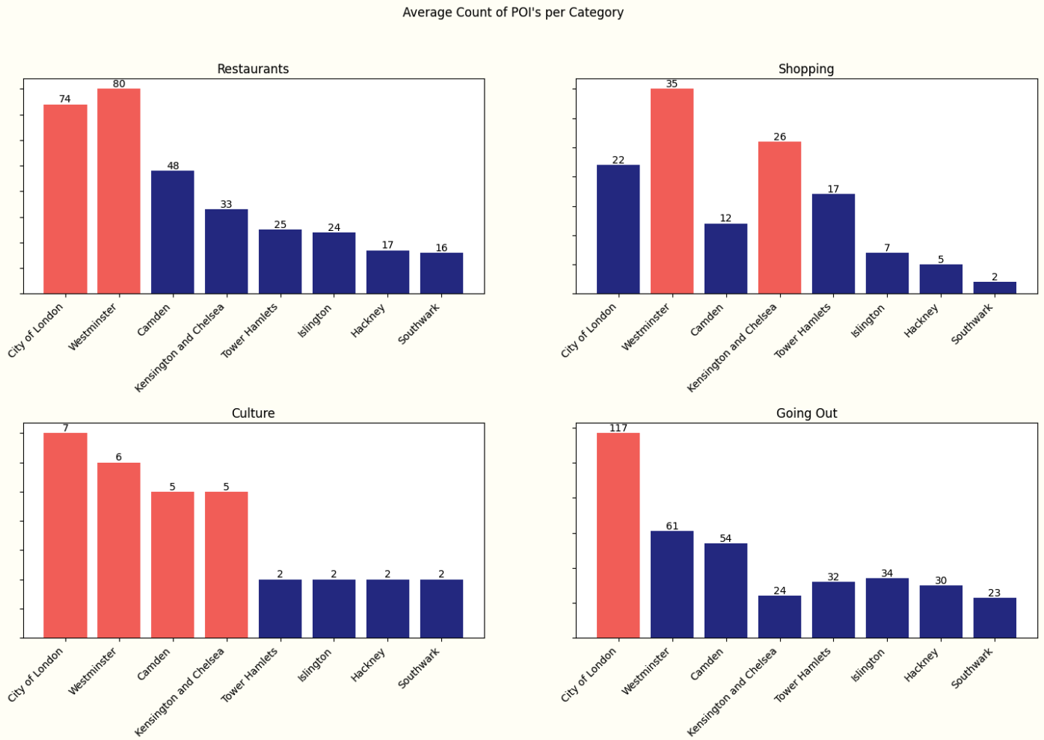
FIND YOUR NICHE!
Top gastronomy neighbourhoods:
City of London & Westminster
Top shopping neighbourhoods:
Westminster & Kensington and Chelsea
Top tourist attraction neighbourhoods:
City of London, Westminster, Camden & Kensington and Chelsea
Top party neighbourhood:
City of London
Notes:
as you can see, recommendations for airbnbs in different neighborhoods vary extremely depending on what points of interest the traveler wants nearby
Read slide aloud
but usually tourist needs are composed of more than one criterion. That's why we designed two user profiles and analyzed how their interests affect the selection of neighborhoods…

Slide 12
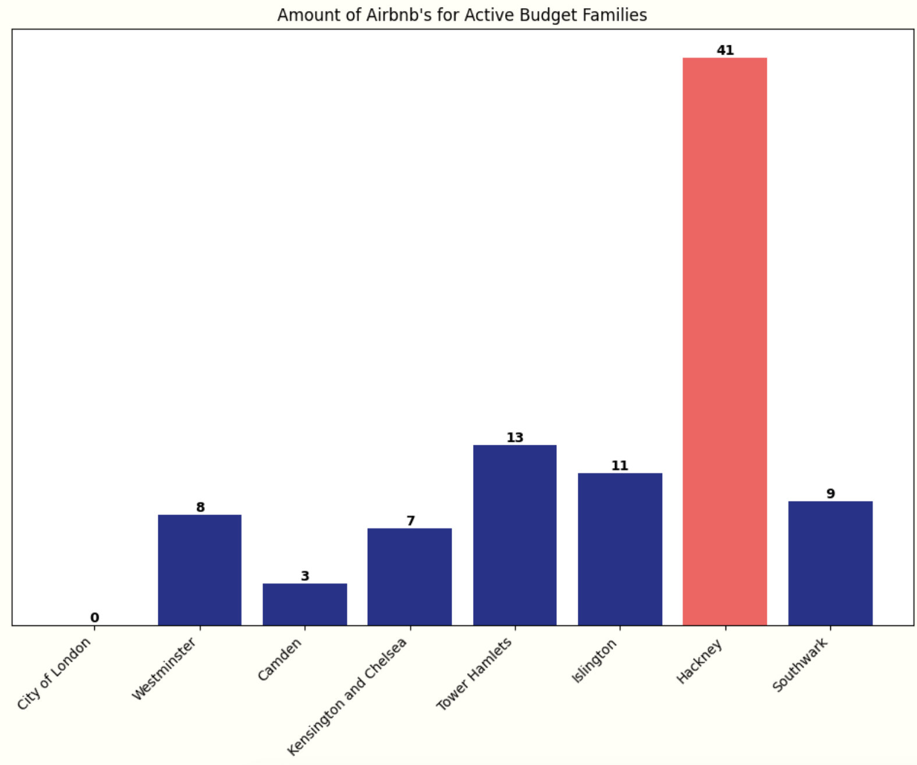
LONDON FOR ACTIVE BUDGET FAMILIES
focuses on
budget accommodations
affordable restaurants
a vibrant neighbourhood
2 bedroom apartments
Insider’s Tip: Hackney
reasonable prices for Airbnbs & gastronomy
full of restaurants, cafes etc.
many POI’s to discover

Slide 13
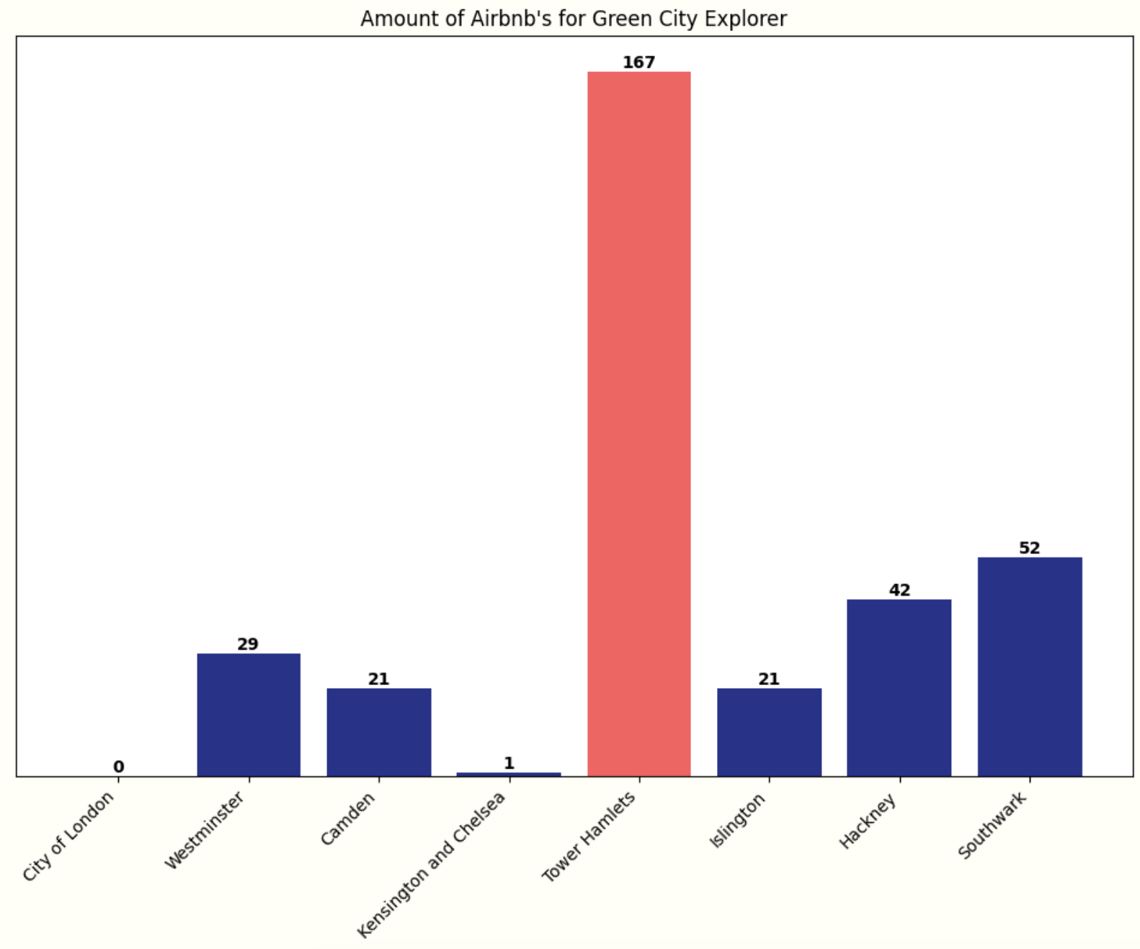
LONDON FOR GREEN CITY EXPLORERS
focuses on
good rated accommodations
easy access to public transport
green environment
private balcony/terrace
Insider’s Tip: Tower Hamlets
many parks and green spaces
less crowded
good access to public transport

Slide 14
DASHBOARD
03
LONDON AIRBNB EXPLORER

Slide 15
ALL IN 1 DASHBOARD
FILTER YOUR INDIVIDUAL NEEDS & INTERESTS
CHECK FOR FAIR PRICES & GOOD RATINGS
UNDERSTAND YOUR NEIGHBOURHOOD BETTER
BOOK DIRECTLY IN THE DASHBOARD

Slide 16
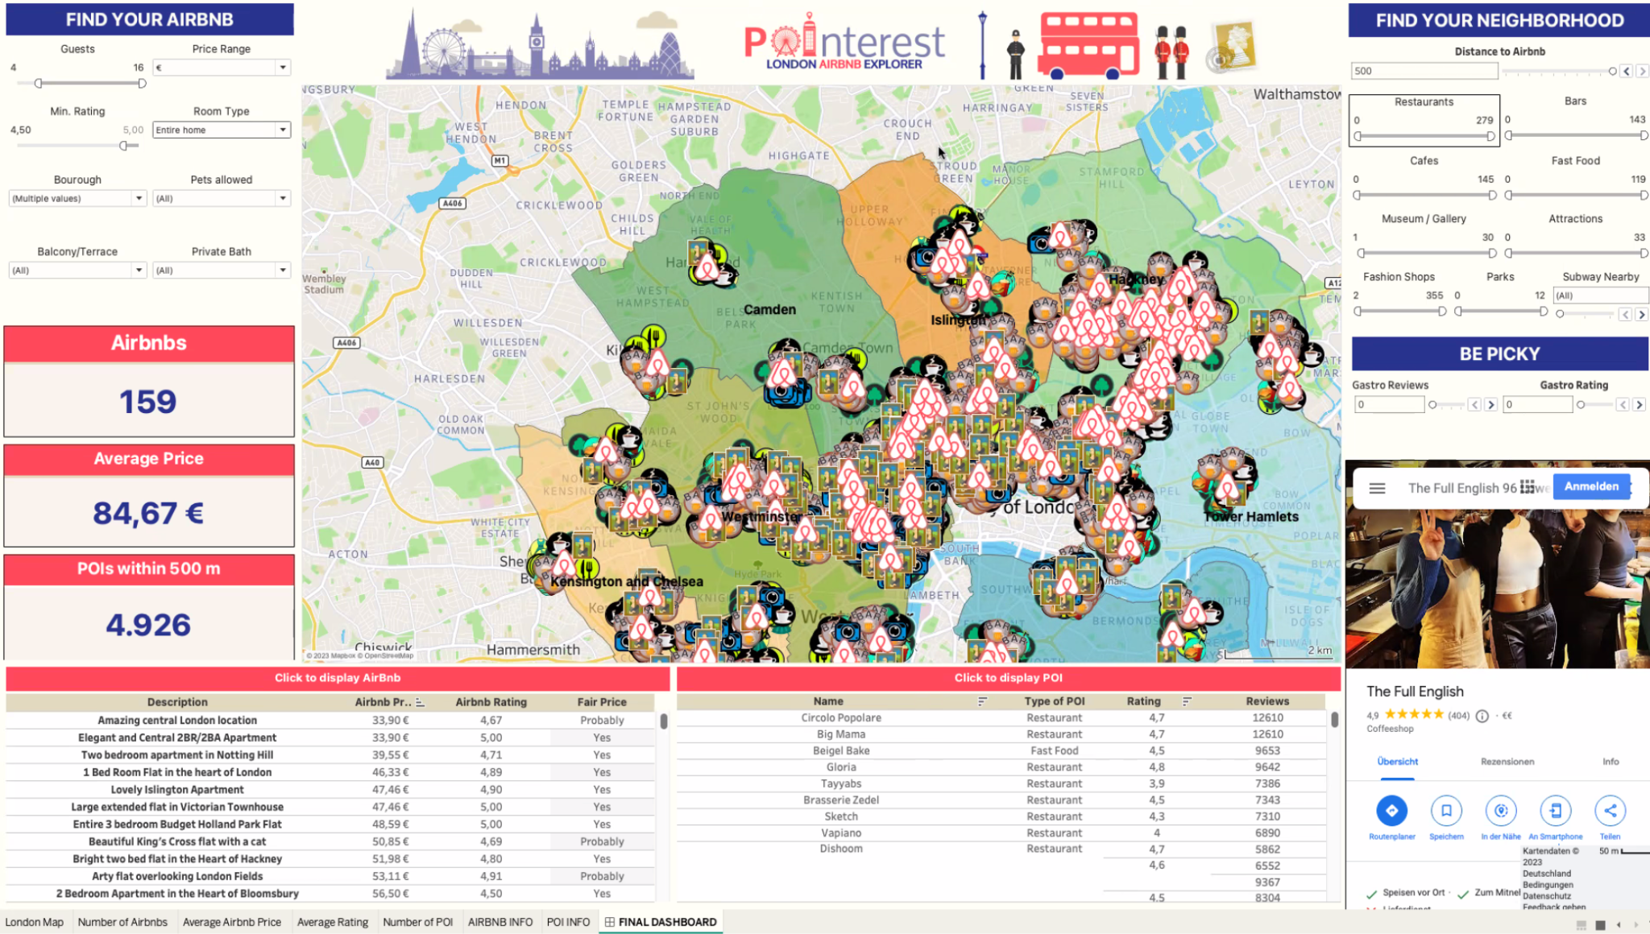
POINTEREST: LONDON AIRBNB EXPLORER

Slide 17
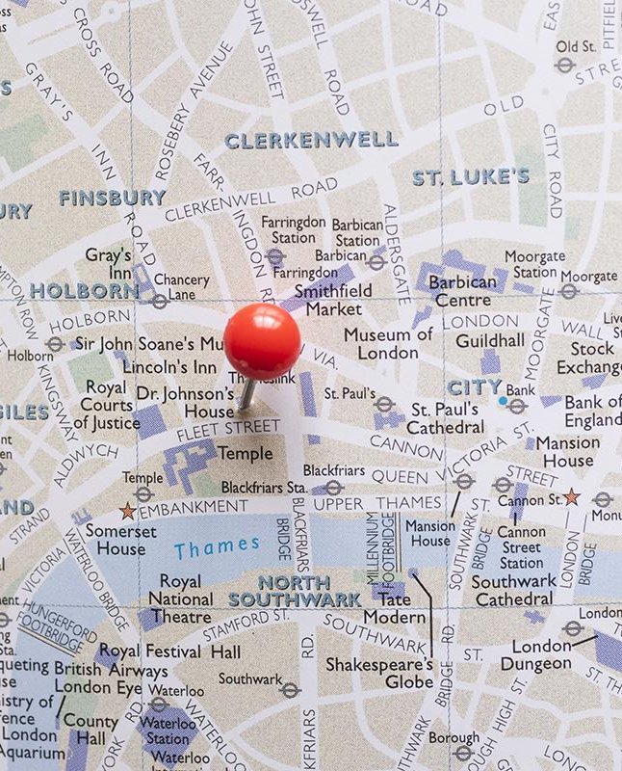
THANK YOU AND SEE YOU IN THE BREAKOUT ROOMS!

